Slide 1


Instructor Resources
Chapter 12 Figures
Cover photo: BeautyStock – stock.adobe.com.

Slide 2
Chapter 12
Airplane Handling, Service, and Maintenance

Slide 3
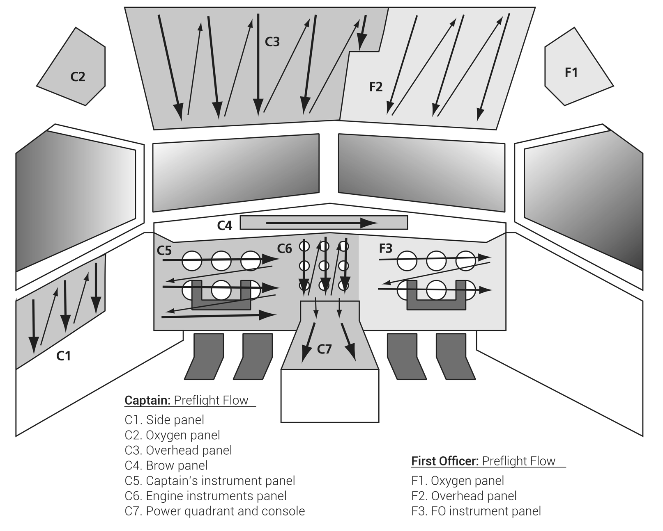
FIGURE 12.1
Flight deck preflight flow checks.

Slide 4
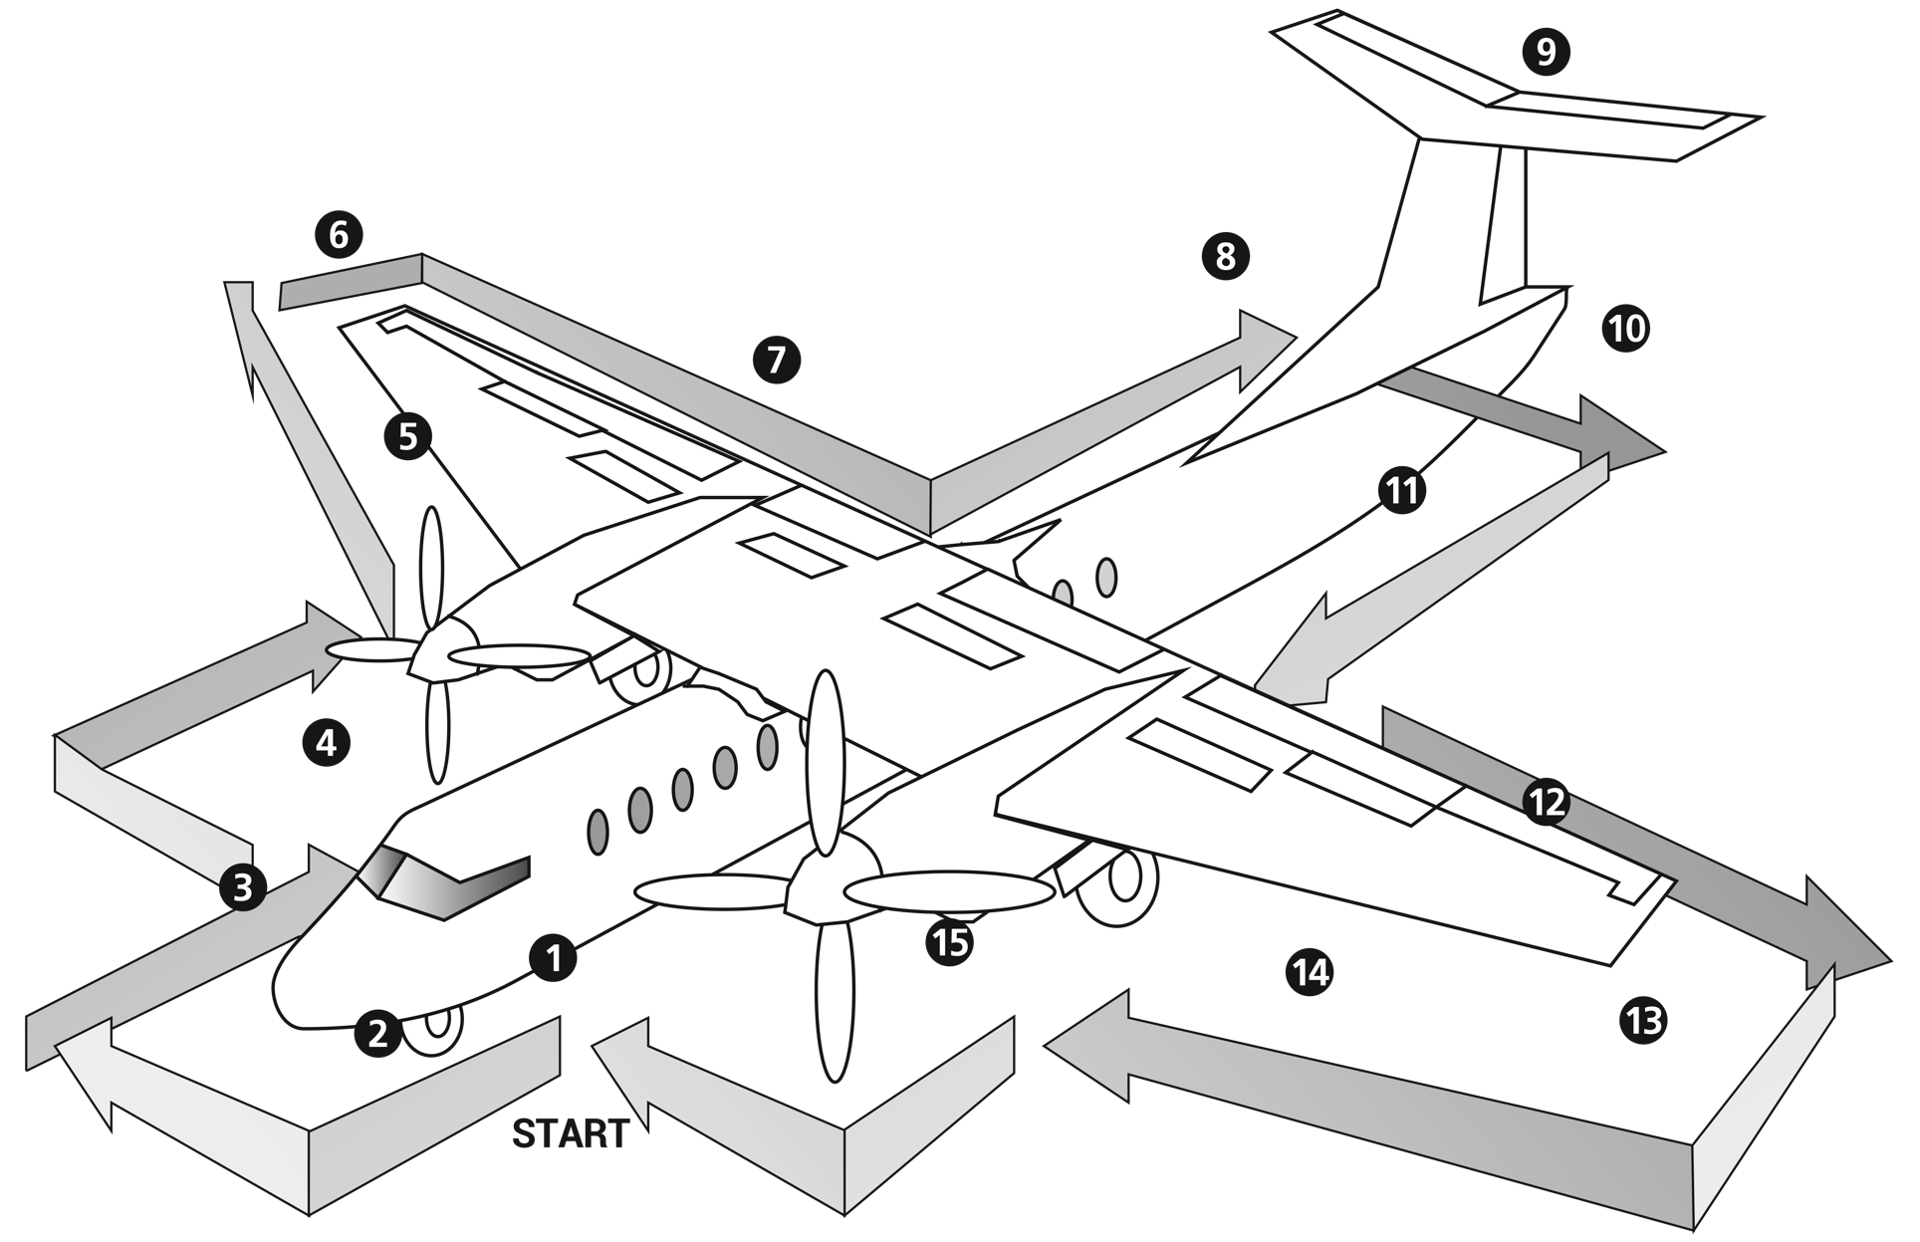
FIGURE 12.2
Exterior preflight inspection.

Slide 5
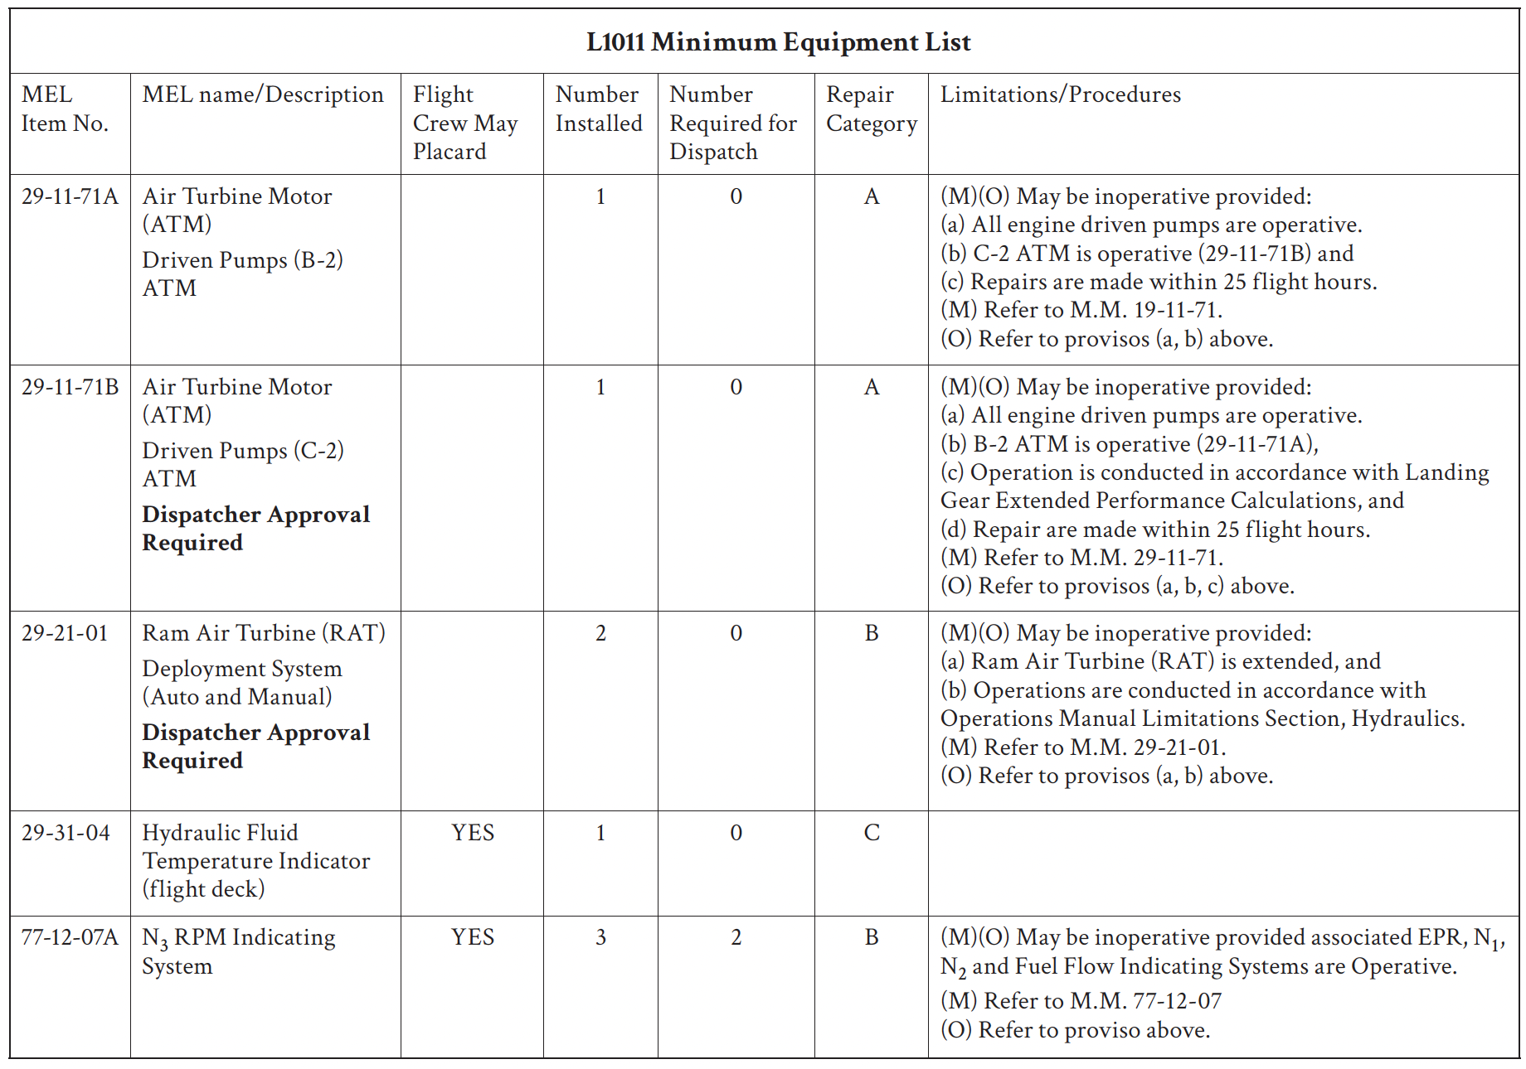
FIGURE 12.3
Minimum equipment list (MEL).

Slide 6
FIGURE 12.4
Sample nonessential equipment and furnishings (NEF) page.

Slide 7
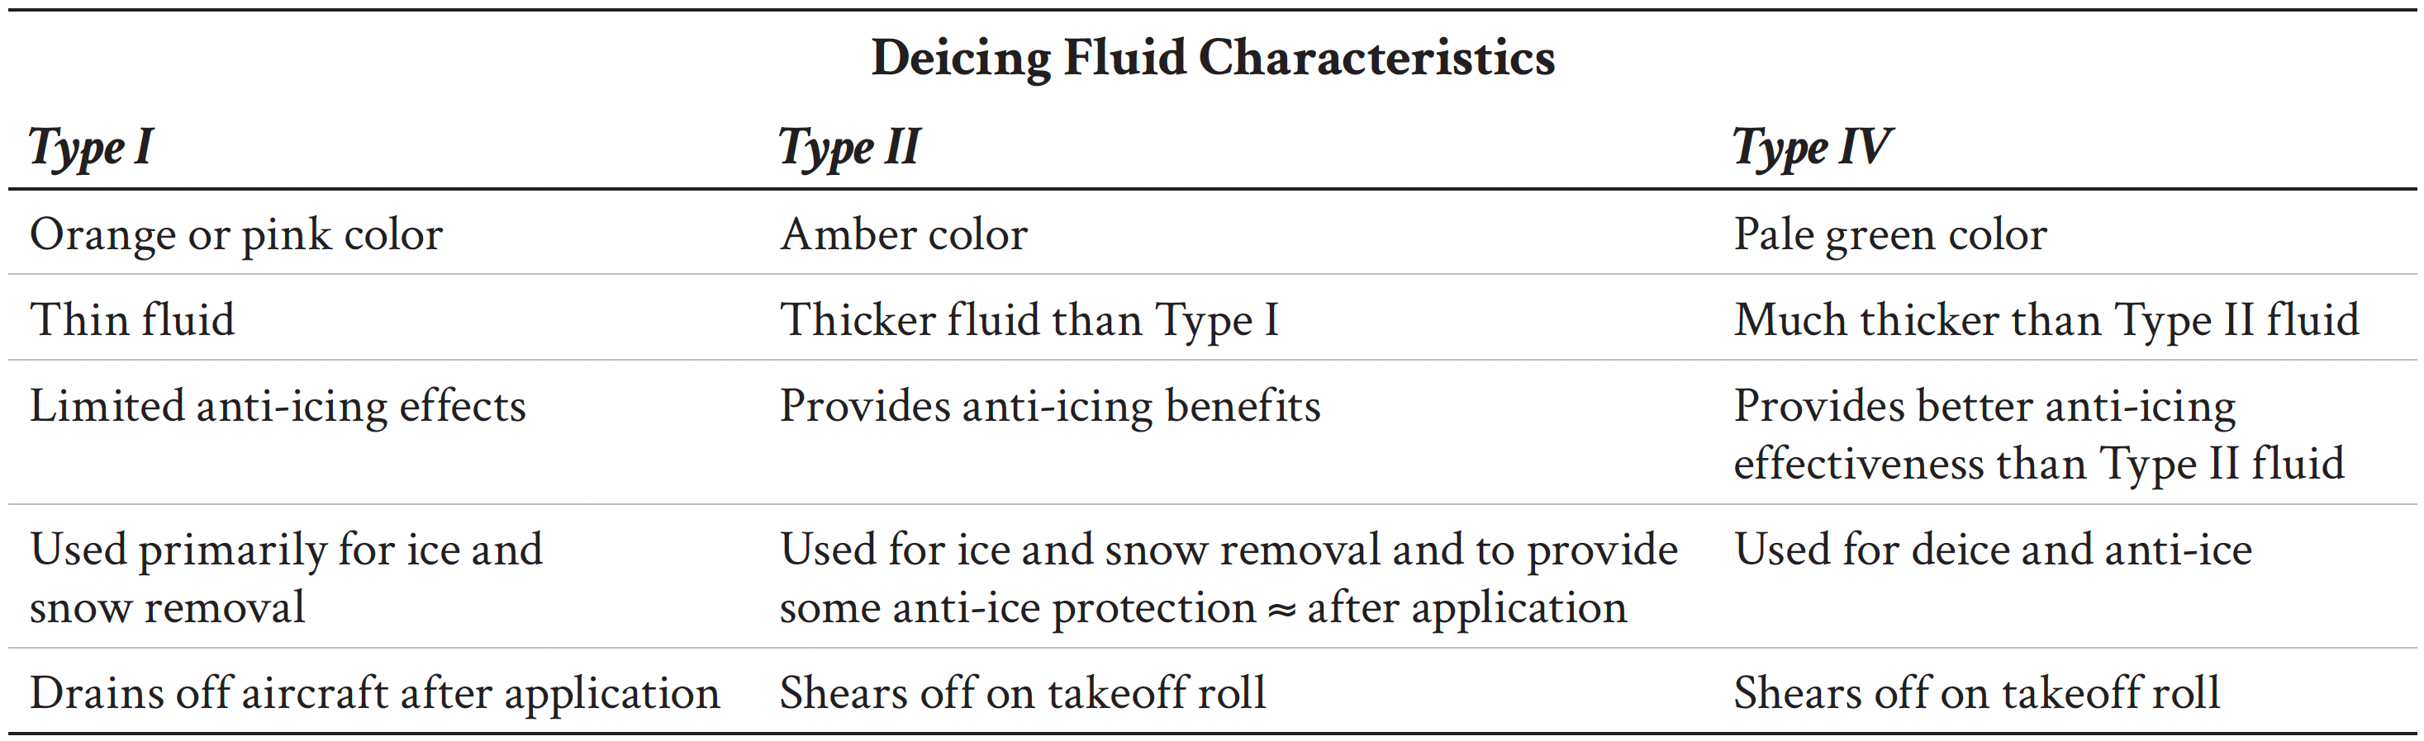
Deicing Fluid Characteristics

Slide 8
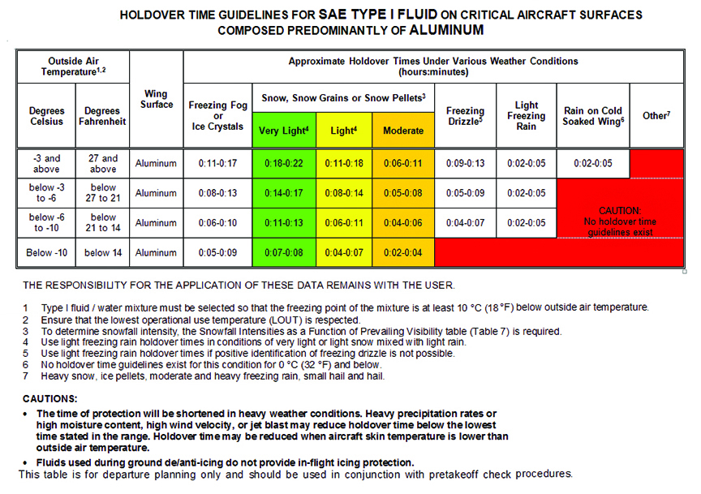
FIGURE 12.5
Sample FAA holdover time guidelines for SAE Type I Fluid on critical aircraft surfaces composed predominantly of aluminum. (Example only; not for actual use.)

Slide 9
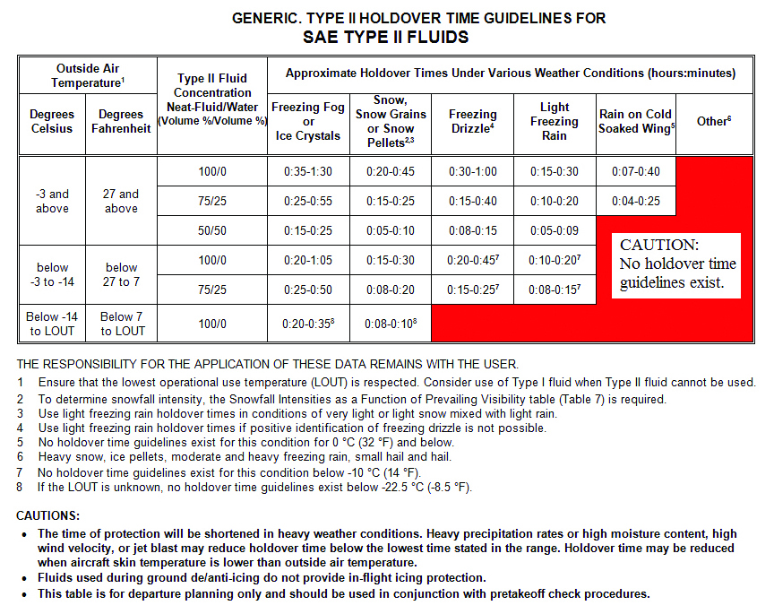
FIGURE 12.6
Sample FAA holdover time guidelines for SAE Type II Fluids.
(Example only; not for actual use.)

Slide 10
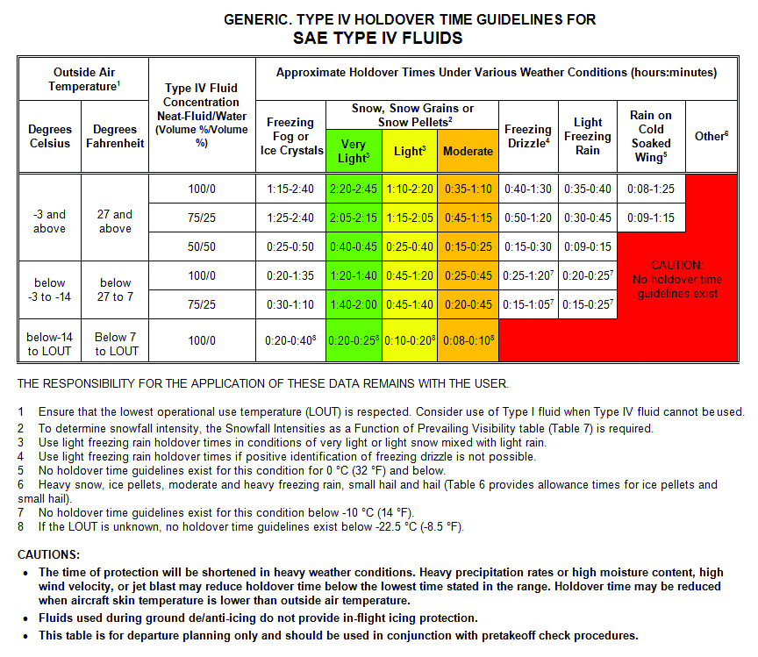
FIGURE 12.7
Sample FAA holdover time guidelines for SAE Type IV Fluids. (Example only; not for actual use.)

